Slide 1
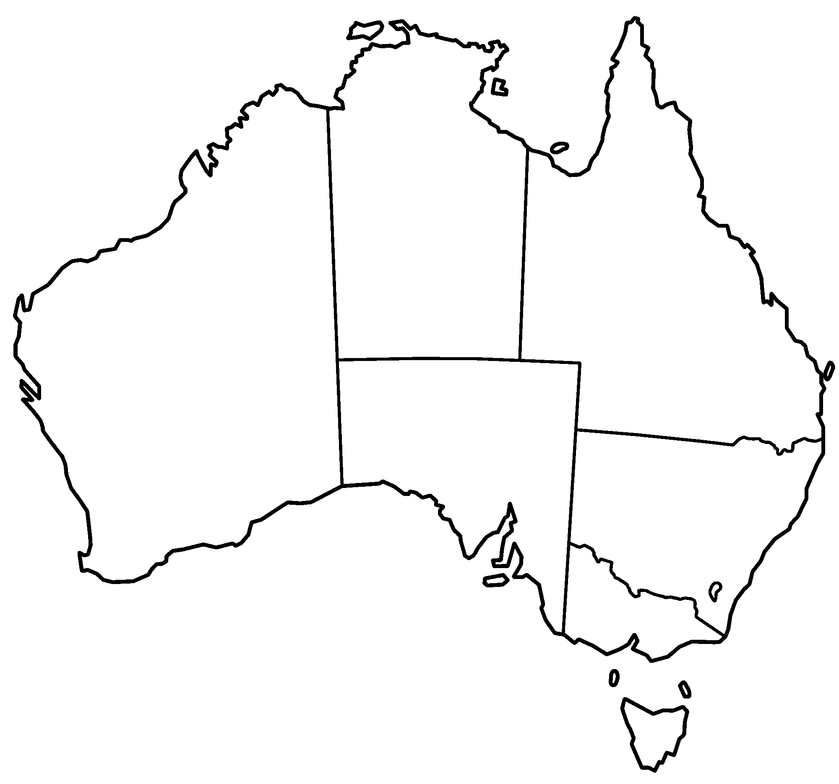
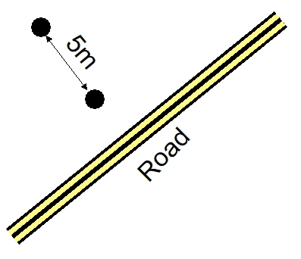
Alice Springs
Namatjira Dr
Larapinta Dr
N
Hermannsburg
Unburnt
Burnt
Road

